Slide 1
POWERLIFTING:
Predicting Totals
Melissa Wright, Will Maher, Kai Wu

Slide 2
What is Powerlifting?
Powerlifting is a sport where each competitor gets three attempts each to lift maximal weight in the Squat, Bench, and Deadlift

Slide 3
Project Goals
Any lifter’s goal is to achieve the highest total possible. However, it can be difficult for coaches to decide what weight a lifter should attempt next, especially if a lift is failed. This project aims to predict a lifter’s final total using their first attempts and more.
We will focus on only the USA Powerlifting (USAPL) federation in raw competition (no equipment except for knee sleeves and a lifting belt).

Slide 4
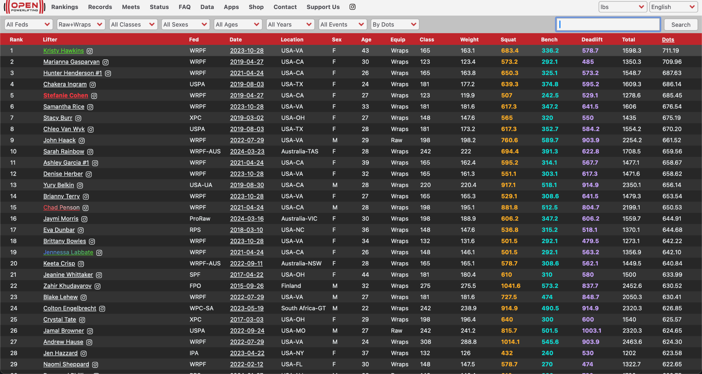

Slide 5
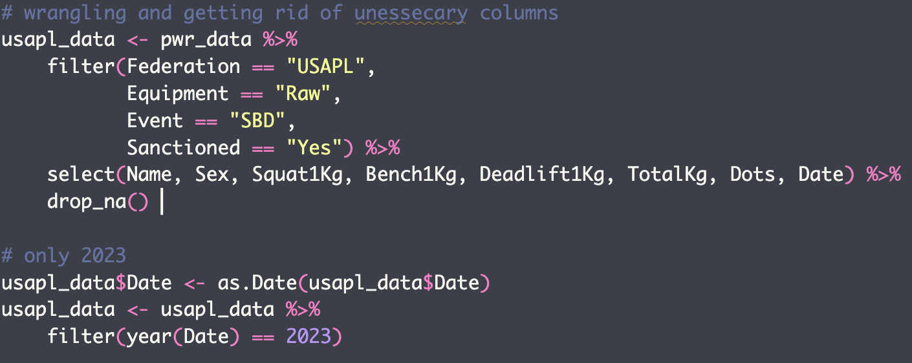

Slide 6
01
Data Audit

Slide 7
VARIABLE SELECTION
This dataset provides many interesting variables, such as all attempts a lifter makes, their Wilks/Dots/Glossbrenner/etc. scores (different formulas that seek to normalize totals across different genders and body weights), and more. These, however, are not known before the final lift and may result in multicollinearity, so they should not be considered.

Slide 8
Numeric Variables
Attempt #2
Age
01
An athlete will increase weight
03
Age can impact muscle maturity and strength
Opener
Body Weight
The opener is the lifters first attempt for each lift
02
Body weights are divided into weight classes to ensure fair competition
04

Slide 9
Categorical Variables
Weight Class
Division
There are 12 weight classes for men ranging from 52 kg to 140+ kg and 11 for women, ranging from 44 kg to 100+ kg in the USAPL federation.
There are different age divisions in a given federation. Youth (10-14), teen (14-20), junior (20-24), and masters (>44) are the key divisions in the USAPL. There is also an open division for every lifter >14.
*Note, we will need to decide between using these categorical variables and the previously mentioned bodyweight/age numeric variables

Slide 10
02
Descriptive Analysis

Slide 11
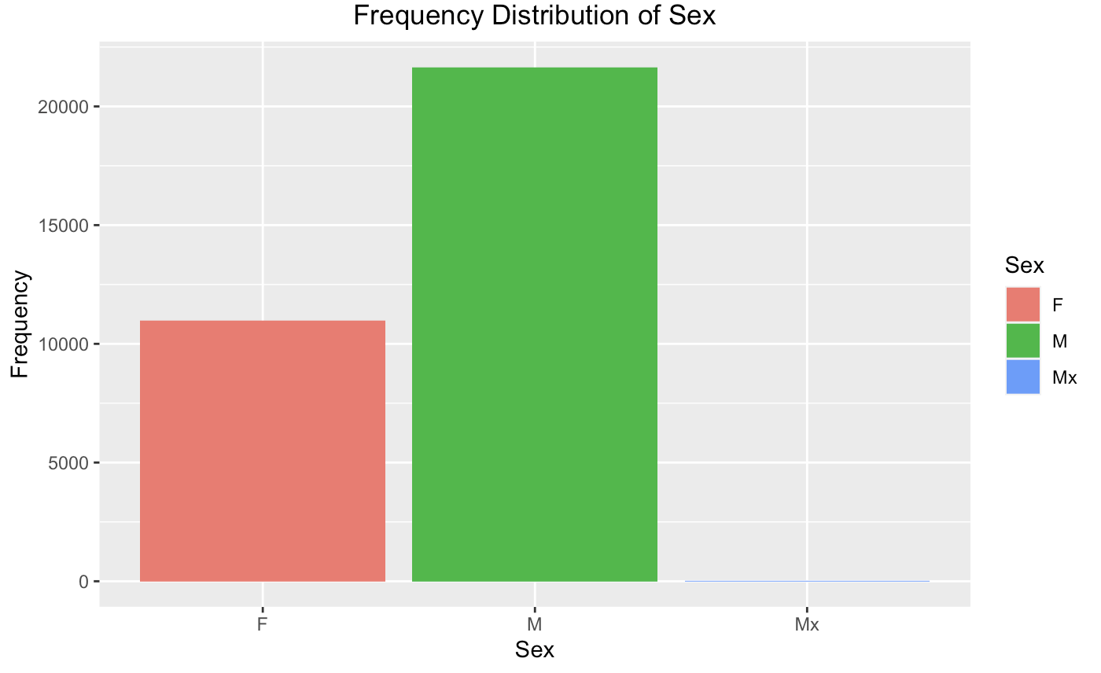
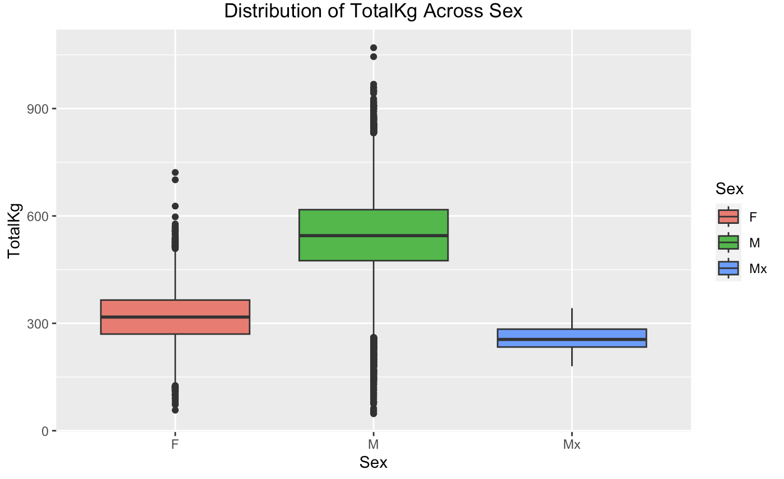
Gender Distribution & Performance Analysis

Slide 12
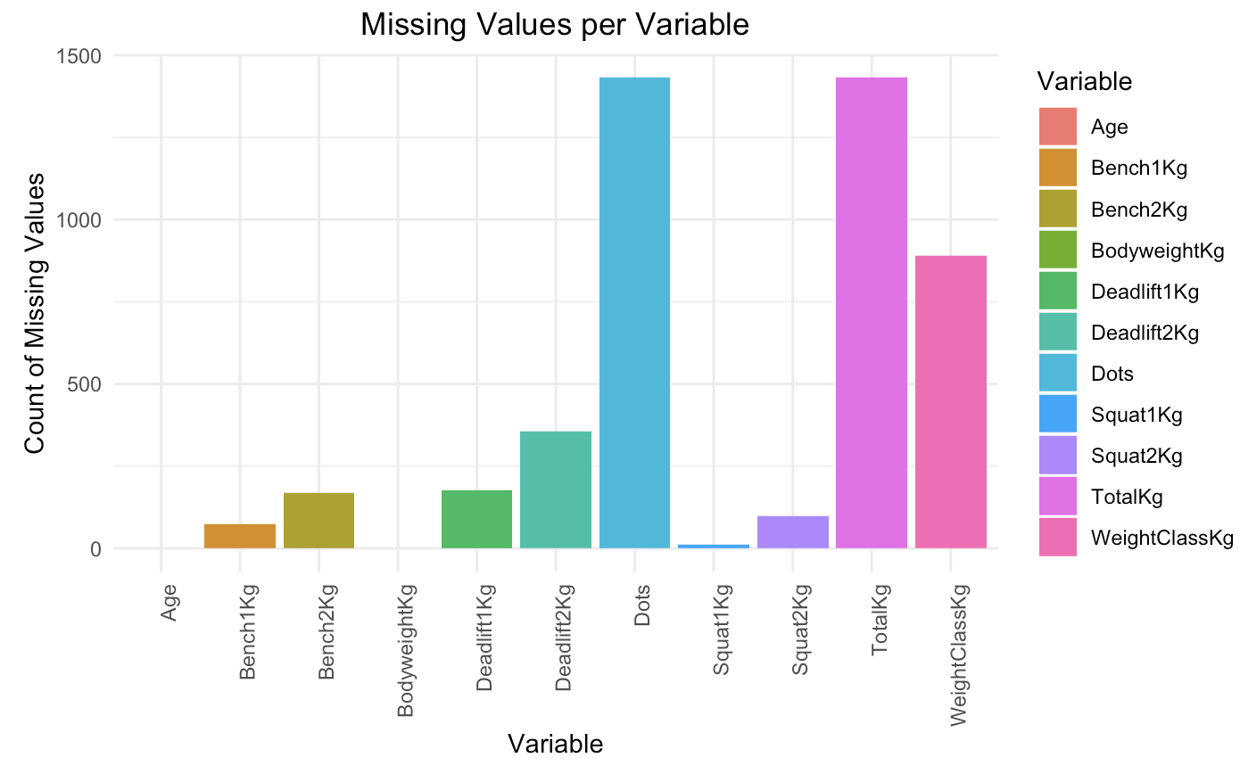
Analysis of Missing Data in Powerlifting

Slide 13
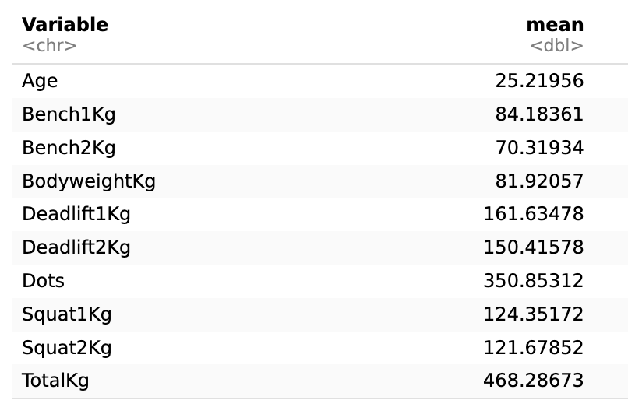
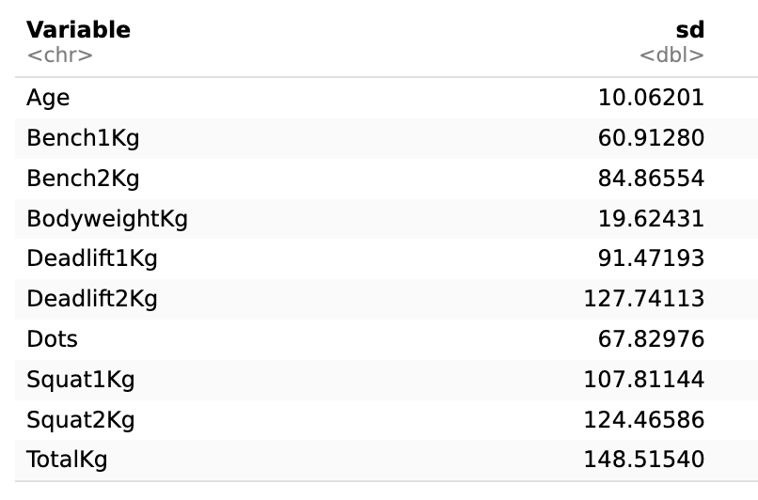
Descriptive Statistics of Interval Variables
Mean Value
Standard Deviation

Slide 14
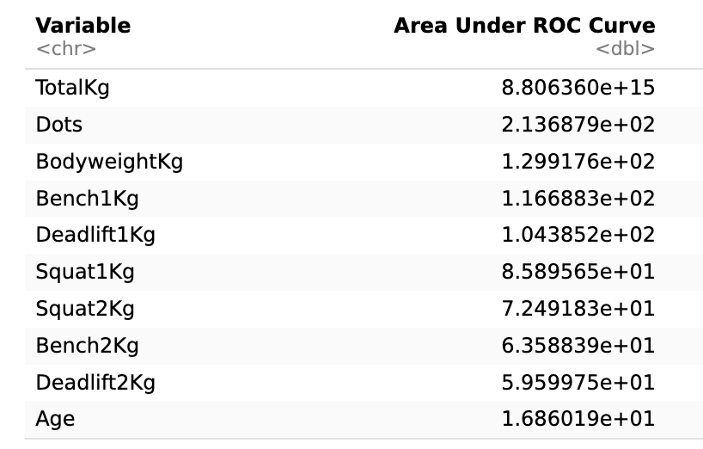
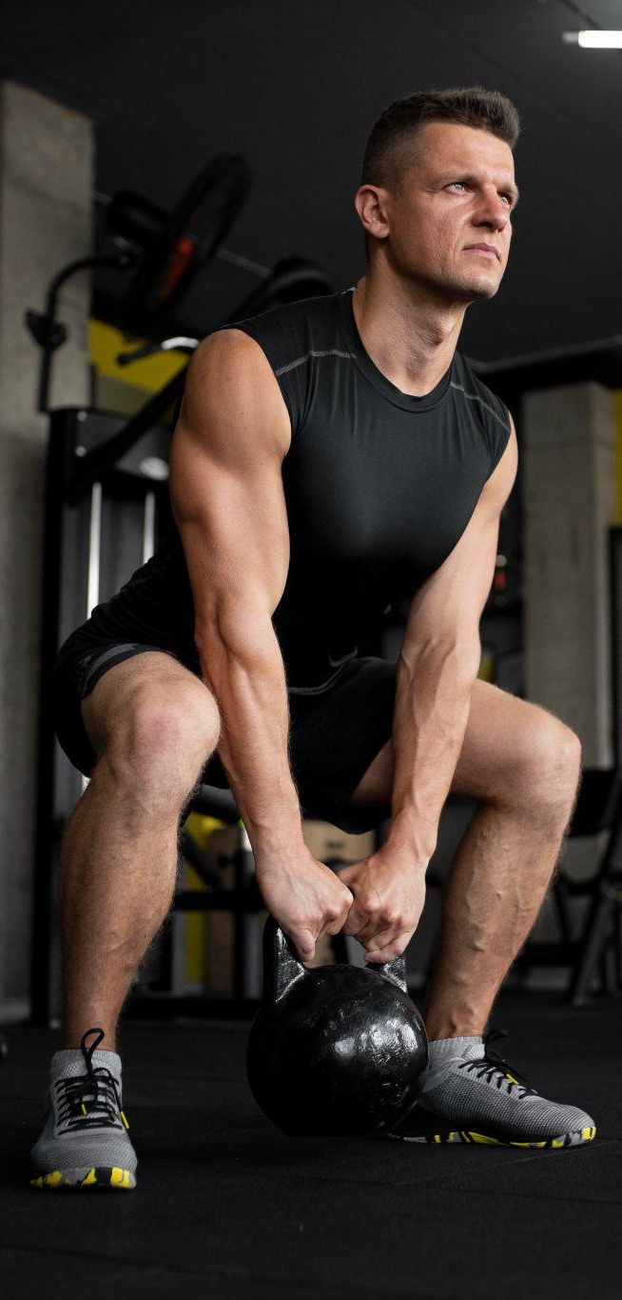
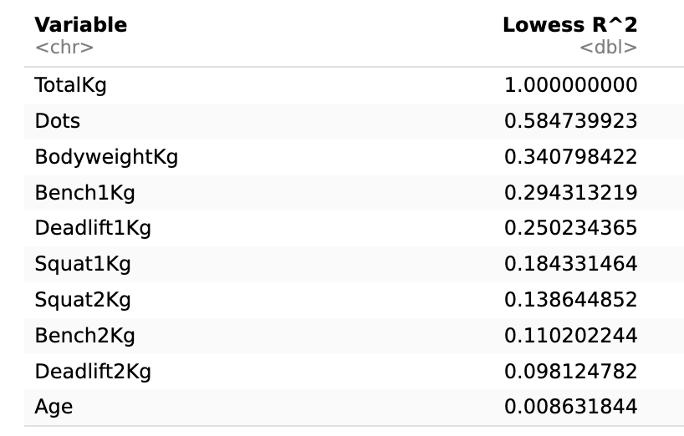
Variable Importance Measure
Area under ROC curve
Lowess R^2
Pearson Correlation

Slide 15
Thank you!
Any questions?

